Slide 1
Using Life Cycle Assessment of pavement to quantify GHG emissions
Maeve Chen
Mentor: Haoran Li
Concrete Sustainability Hub

Slide 2

Transportation makes up 28% of all GHG emissions in the U.S.
Notes:
TOTAL GHG

Slide 3
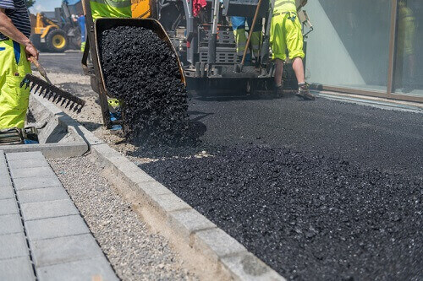
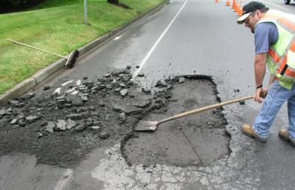


Roads emit a lot of greenhouse gas
Construction
Maintenance & Repair
Usage
Life Cycle Assessment Tool
Notes:
Roads create a lot of greenhouse gas emissions throughout their lifetimes. GHG are emitted in the laying of roads, maintenance and repair, and through daily usage.

Slide 4
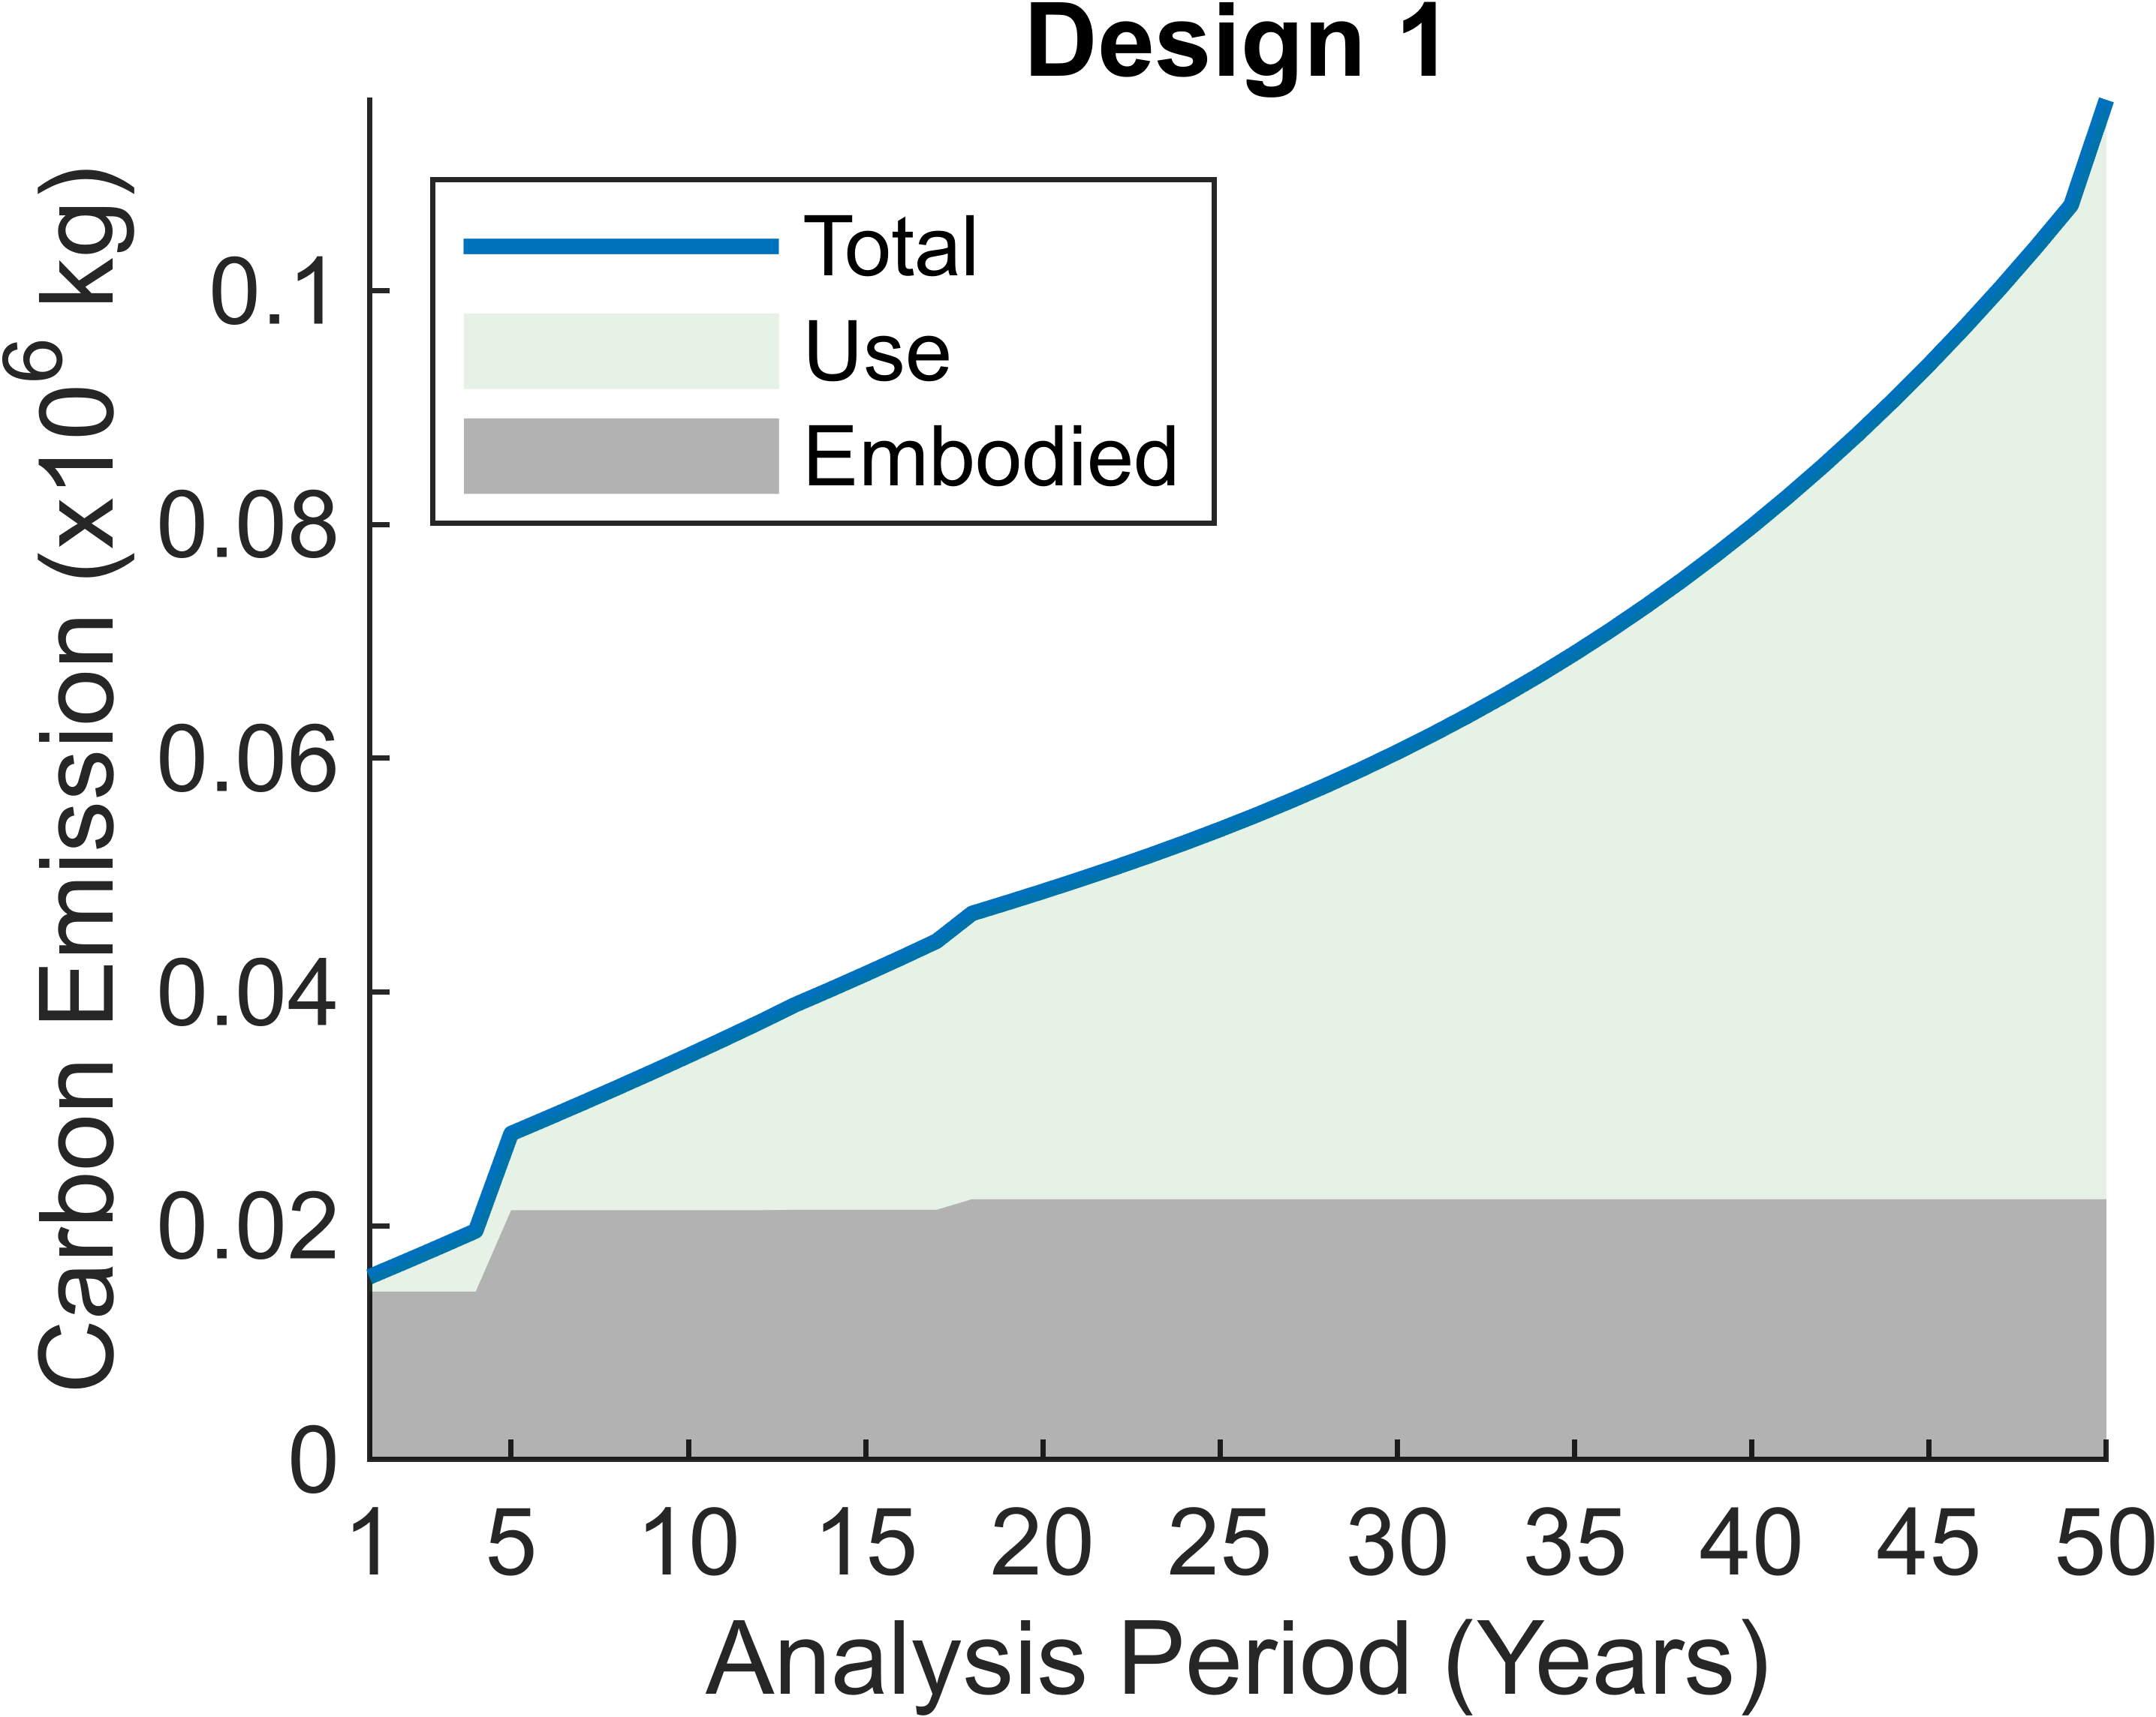
Roads emit a lot of greenhouse gas
Construction
Maintenance & Repair
Usage
Life Cycle Assessment Tool
Notes:
My mentor developed an app Haoran that analyzes a road, considers all these factors,

Slide 5
Roads emit a lot of greenhouse gas
Construction
Maintenance & Repair
Usage
Life Cycle Assessment Tool
Notes:
and outputs a bunch of graphs that basically assess the quality of this design.
the key graph that I wanted to focus on is the GHG emissions of this design over its life

Slide 6
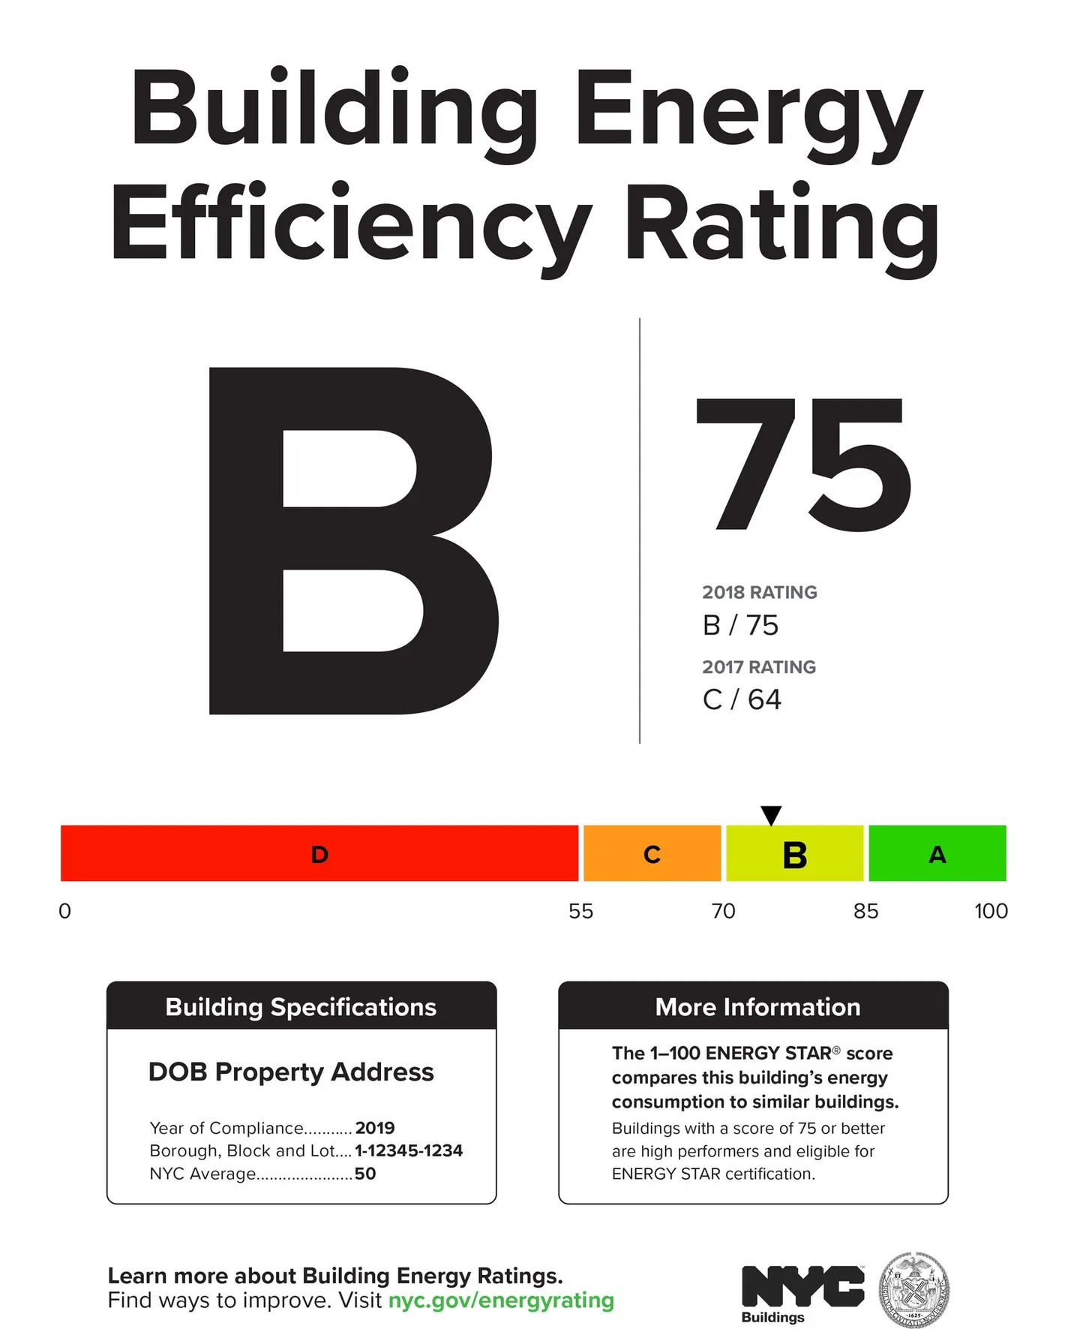
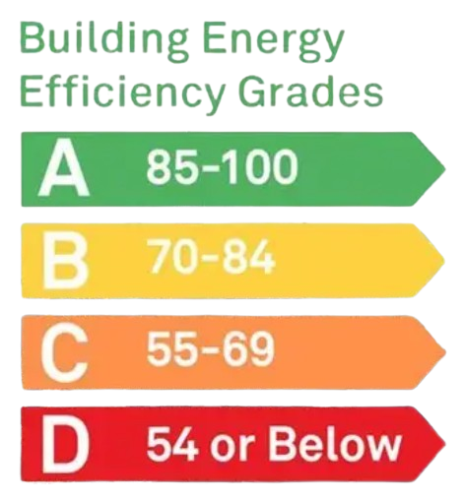
Notes:
Most of you may have seen something like this on the side of a building.

Slide 7
Notes:
This system grades the building on its energy efficiency. I aimed to create a system that similarly analyzes the GHG efficiency of roads

Slide 8
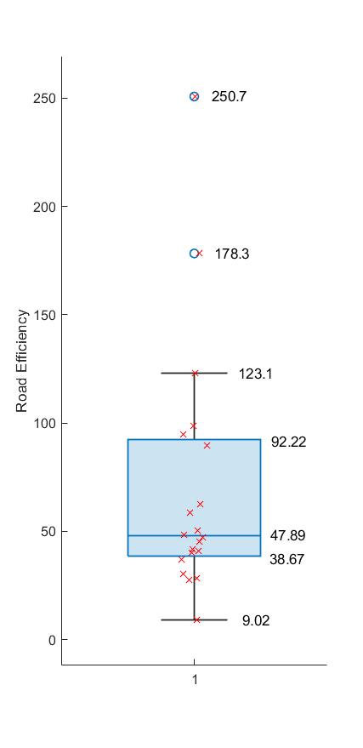
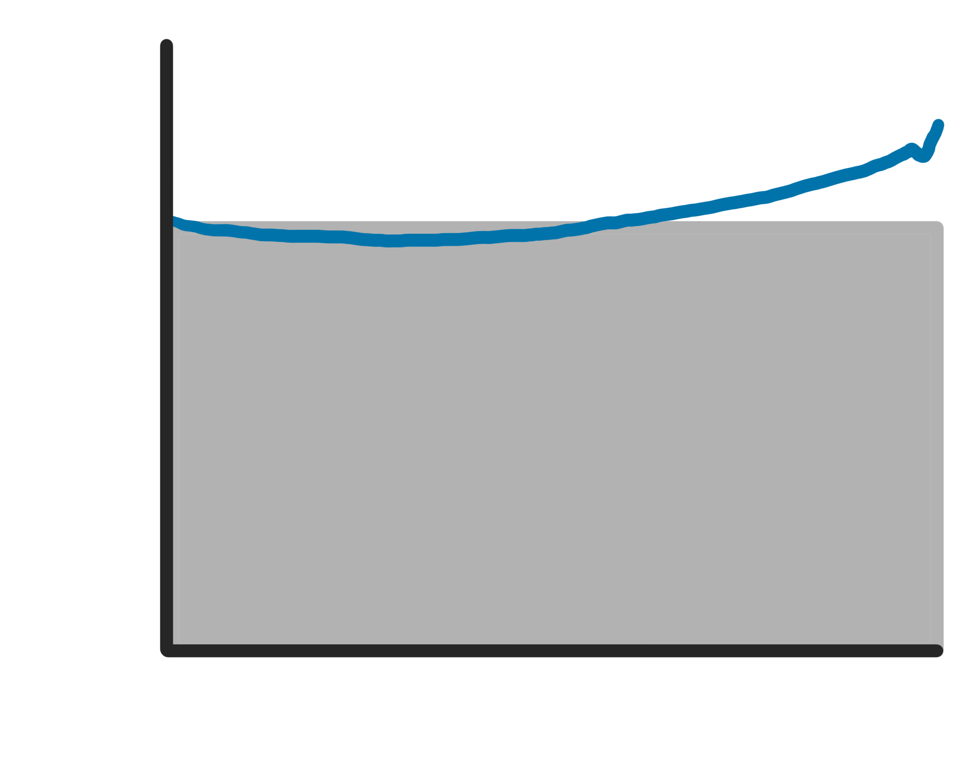
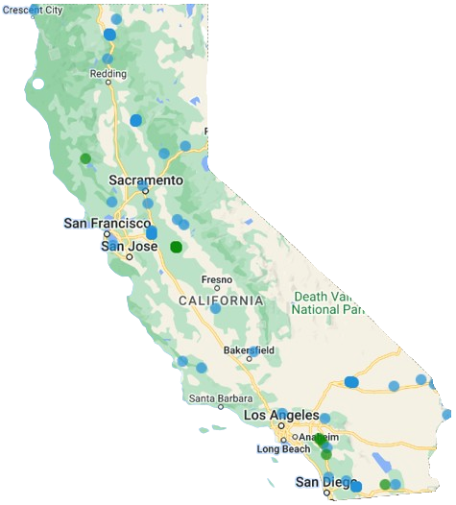
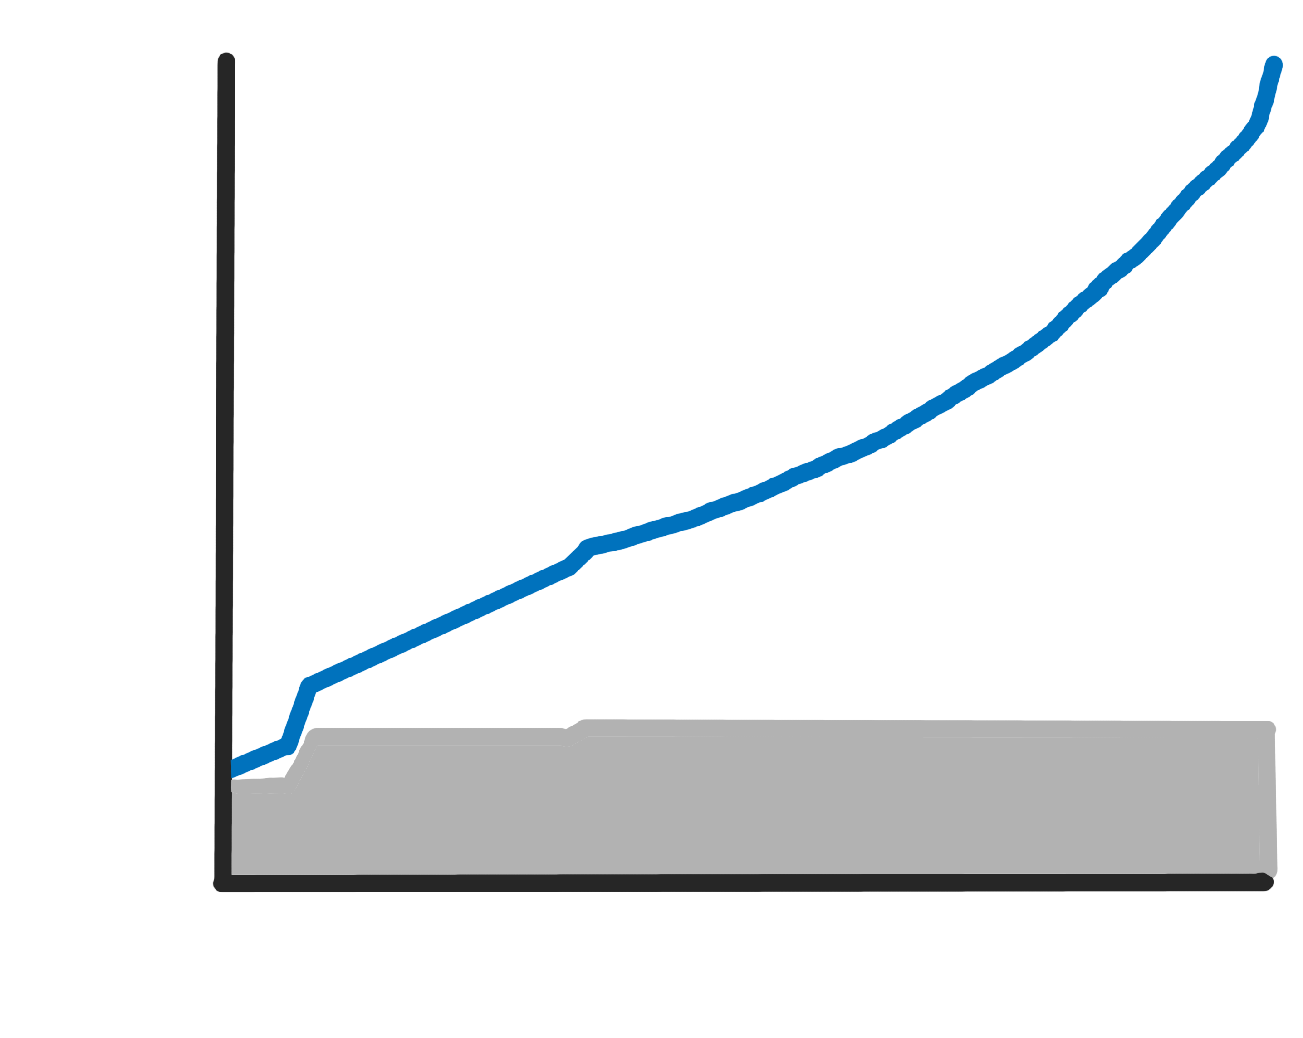


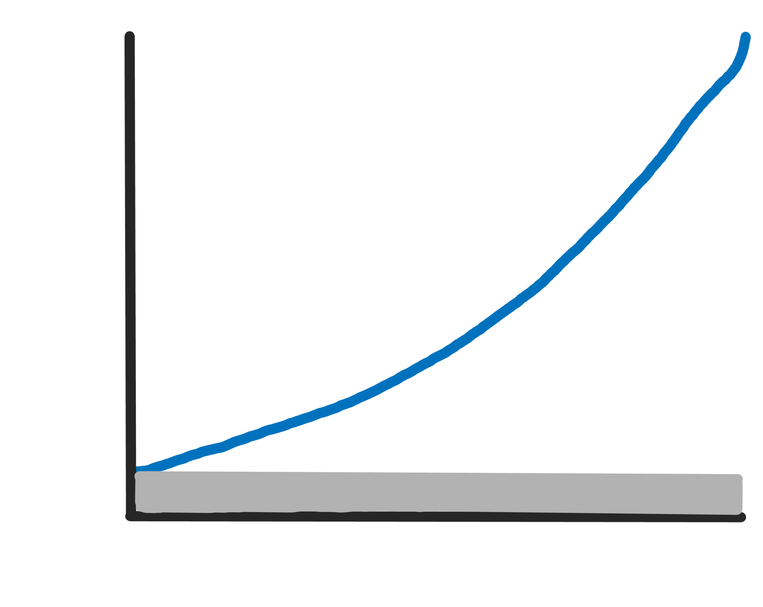

Sample Procedure
06-0501
20
06-3024
06-9048
Notes:
As a sample set, I considered 20 roads in California with similar properties. I processed them through the LCA tool, go these graphs, and then I took the final value of each graph, which is the total GHG emission of the roads over their lifetimes

Slide 9
Sample Procedure
06-0501
20
06-3024
ROAD TEST SAMPLE DATASET
06-9048
- California
- Rural Major Arterial/Interstate
Notes:
And created a box plot. Now this graph is a little hard to read. Lets crop a little bit

Slide 10
Sample Procedure
06-0501
20
06-3024
ROAD TEST SAMPLE DATASET
06-9048
- California
- Rural Major Arterial/Interstate
Notes:
Expand

Slide 11
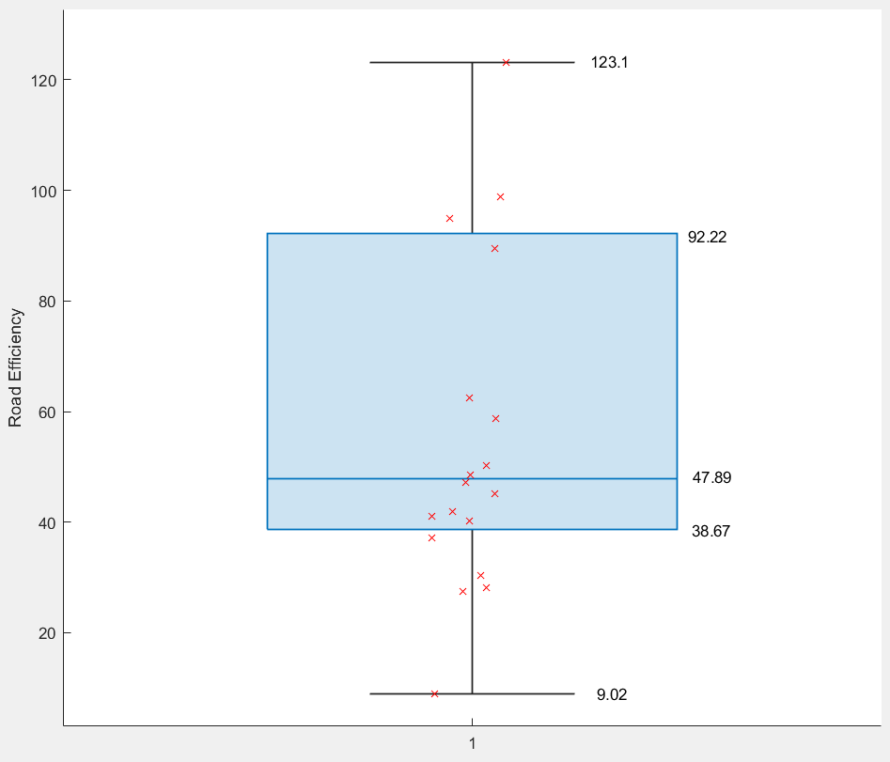
Notes:
And simplify

Slide 12
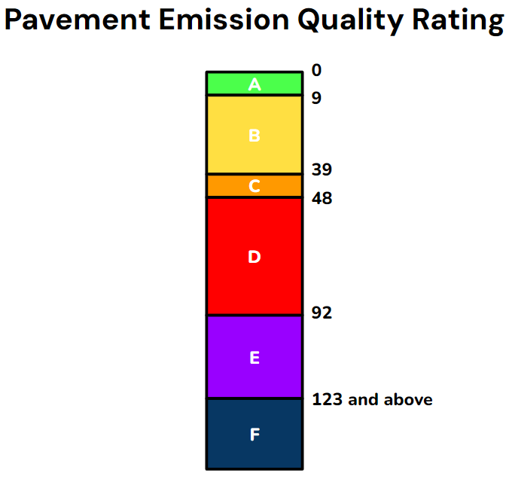
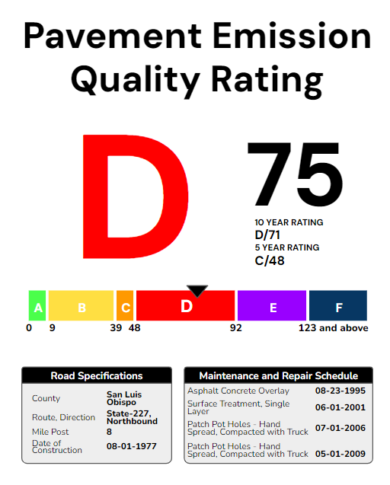
06-3013
Notes:
And you’re left with something very similar to the building energy efficiency system.

Slide 13
06-3013
Notes:
To increase the effectiveness of this system, the next step would be to consider a larger data set. However, this information can still be used to help contractors and city officials assess the environmental impact that building a road may have.

Slide 14
Any Questions? Thank you for listening!

